Slide 1

Ứng dụng mobile giúp người bị tự kỷ nhận diện cảm xúc trong hội thoại
FaceMe
CAPSTONE PROJECT 1
CMU-CS 447 AIS
ĐỒ ÁN CDIO 2
GROUP 6
Nguyễn Thành Danh - 2221125770
Bùi Đức Dương - 24211216092
Từ Mỹ Ngân - 2320117977

Slide 2
Project Introduction
Application Description
State of the art
Technical problems and solutions
Project Management

Slide 3
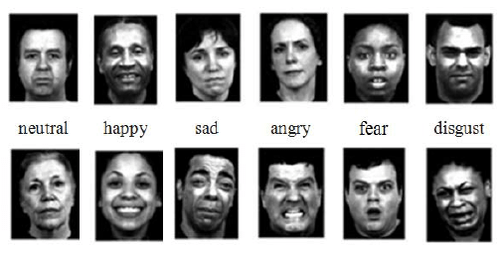
I. Project Introduction:
THE PROBLEM:
- The ability to recognize and imitate facial expressions of emotion is crucial to establishing interpersonal connections early in life. Recognition of facial expressions is one of the primary signals used to understand the feelings and intentions of others, and it has been argued that the ability to recognize basic emotional expressions may be universal.
- Yet many researches have shown that some groups of autism patients display difficulties in such tasks, which usually led to their detachment from social life.

Slide 4
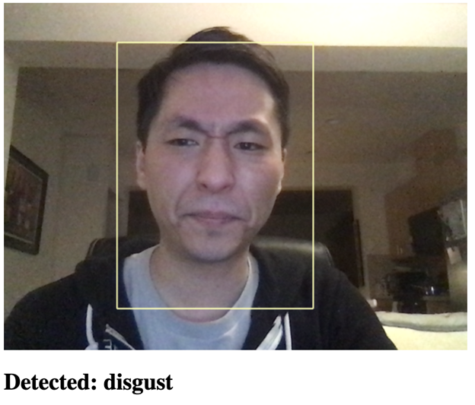
2. OUR SOLUTION:
That’s why in this project we will develop a mobile app that can detect the emotional change of a person in real-time and give subtle alerts to the user, assuming someone with autism, so that they can try to navigate the conversation to a positive end.

Slide 5
II. Application Description:
Function:
Detect change in a person’s emotion through their facial expression.
Send an alert to the user, using the system’s capacity to notify the flow of the conversation.

Slide 6
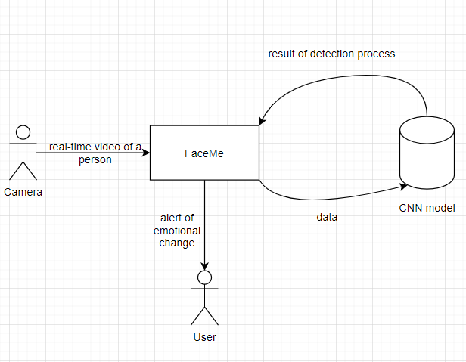
2. System context diagram

Slide 7
III. State of the art
In this section we present the SWOT analysis of our own application and some other available ones on the market:
- FaceMe
- AffdexMe

Slide 8
FaceMe is a mobile application developed as a tool specifically designed to assist people with trouble recognizing facial expressions in daily life conversations.
Strengths | Weaknesses
Use CNN model to detect emotional expression. Useful and subtle design. | Can only help recognizing emotional expression. Developer team is inexperienced. Low budget.
Opportunities | Threats
There’s not much competition. | Might be treated as a breach of privacy of other people.

Slide 9
AffdexMe demonstrates the use of Affectiva's Affdex Software Developer Kit (SDK), which lets developers emotionally-enable their apps and digital experiences.
Strengths | Weaknesses
The app analyzes and responds to facial expressions of emotion in real time using the built-in camera on your Android/IOS device. | Limited emotional awareness Most of the time emotions are wrongly classified to Joy. If teeth are visible the emotion is detected as Joy irrespective of actual real joy. Seemingly still in development. Accuracy is not high.
Opportunities | Threats
The first pioneer app for free. Uses new technology. | Didn't really get the point. Crashed many times. Has many negative feedbacks.

Slide 10
IV. Technical problems and solutions
1. Precise emotional expression reading result using AI technologies.
CNN model, OpenCV
2. Developing a pure python application in an android environment.
BeeWare, VOC
3. How to deploy the application in real life situations
Using a mini camera that can play as a brooch or an accessory.

Slide 11






V. Tools

Slide 12
VI. Master plan
NO | Task Name | Duration | Start | Finish
1 | Start-Up | 15 days | 26/08/2021 | 06/09/2021
1.1 | Project’s Kick-off Meeting | 2 day | 26/08/2021 | 27/08/2021
1.2 | Create Document | 13 days | 28/08/2021 | 06/09/2021
2 | Development | 45 days | 07/09/2021 | 22/10/2021
2.1 | Sprint 1 | 15 days | 07/09/2021 | 21/09/2021
2.2 | Sprint 2 | 20 days | 22/09/2021 | 11/10/2021
2.3 | Sprint 3 | 10 days | 12/10/2021 | 22/10/2021
3 | Final release | 1 day | 23/10/2021 | 23/10/2021

Slide 13
VII. Cost Estimation:
Description | Amount | Unit
Number of members | 3 | Person
Number of working hours per day | 4 | Hour
Number of workdays/week | 5 | Day
The duration of the project | 61 | Day
The number of working hour | 732 | Hour
Other costs (Internet, foods, drinks, meetings, fuel…) | 100 | USD
Description | Amount | Unit
Number of members | 3 | Person
Number of working hours per day | 4 | Hour
Number of workdays/week | 5 | Day
The duration of the project | 61 | Day
The number of working hour | 732 | Hour

Slide 14
VIII. Business plan
The application brings a new beginning for people with autism, helping autistic people to recognize the emotions of the opposite person through the application developed by our team. Giving a little help to someone with autism can be more fun and especially social. Because this is a project to help people with autism, our team decided to do it for a non-profit purpose with the hope that those who are suffering from the disease can have fun and mingle with everyone and especially it will be back to normal soon

Slide 15
IX. Quality Attributes
ID | Type | Description | Solution
QA1 | Performance | A conversation is usually fast and continuous, requiring the system to return detection results in the latest of 1 second to avoid bad timing and misunderstanding. | Applying CNN model.
QA2 | Availability | The system needs to run smoothly during a short or long period of time depending on the length of the conversation with equal precision. In case of crashing or memory overloading, reboot the system.

Slide 16
X: Other
Problem definition:
The use of an off-system camera with an unnoticeable camera serves the purpose of making the conversation seem normal. But in some cases it can be treated as a breach of privacy to the other party.
The solution to this is decided that the application will only work on real-time video records and save no aftermath data.

Slide 17
THANK FOR YOUR ATTENTION

Slide 18
Contact Info
Từ Mỹ Ngân
Bùi Đức Dương
Nguyễn Thành Danh
Justmnisfine@gmail.com
dduong0311@gmail.com
thanhdanh11311@gmail.com

